Slide 1

Agile Development
Zachary Abbe

Slide 2
Different Agile Roles
Product Owner-
Increases value of the product and the work of the Development Team
Facilitates meetings with the Client
Scrum Master-
Is the Servant Leader to the Product Owner
Holds the Scrum Events
Provides guidance in using Agile Principles
Dev Team-
Devs and Product Testers
Self-Organized
Multi-Functional

Slide 3
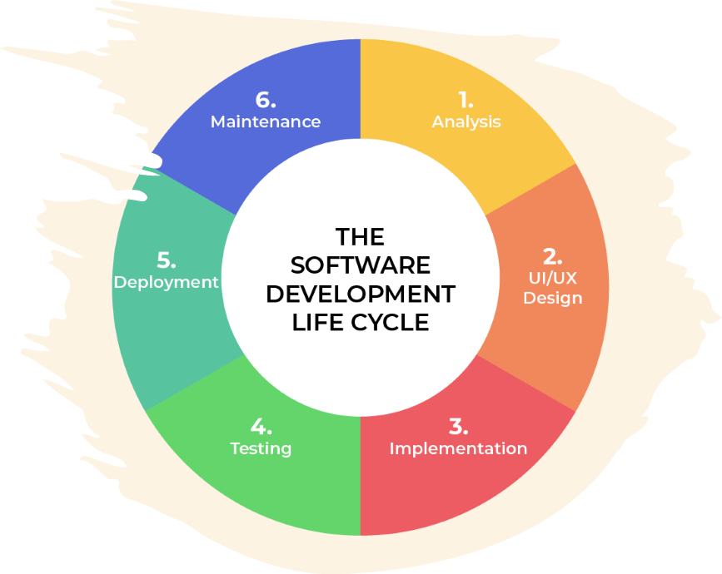
6 Steps in the SDLC (Software Development Life Cycle)
Analysis-
Collaborate with Stakeholders and determine requirements
Design-
Define technologies, limitations, time frames and budgets.
Develop detailed process for functionality.
Implementation-
Development on the product begins.
Functionality is broken up into smaller increments.
Testing-
Occurs in conjunction with Development.
Identify and mitigate reported defects and issue tracking.
Deployment-
Testing Complete and product is released to the market.
Maintenance-
Product is released in a production environment.
Developers must be ready to implement NEW features and bug fixes as they come up.

Slide 4
AGILE VS WATERFALL
AGILE
No need to define all requirements
No time to market constraint
Major requirements can be defined but functionality will be added and will evolve over time as the clients needs change
Offers more flexibility and control over the development over the product
WATERFALL
All requirements must be defined.
Sequential and Linear Stages. Starts from the top and can only test when it reaches the bottom.
Contract Negotiations.
Best use case is for simple flowing projects that aren’t subject to a lot of changes.0

Slide 5
Waterfall approach
With a waterfall approach to development, it becomes difficult to adapt to changes that the client might want made.
It is a slow process and testing is only able to happen at the end of the project, which can lead to massive bugs or errors that will take even longer to fix.
Overall, the waterfall method is a heavier, slower burden to bear as a developer and fails in comparison to the Agile Method.

Slide 6
REFERENCES
Charles G. Cobb. (2015). The Project Manager’s Guide
to Mastering Agile : Principles and Practices for an Adaptive Approach. Wiley. Software Development Life Cycle (SDLC). (2021, May 19). From linkedin.com: https://www.linkedin.com/pulse/software-development-life-
cycle-sdlc-tutorial-richard-harris/

